Slide 1
Northwest Pennsylvania Oil and Gas Hub Business 2 Business Forum

Slide 2
Natural gas exploration is driving torrid growth in PA
p. 2
Gross Economic Impact
Revenues: All Industries | $4,226 million
Revenues: Manufacturing | $376 million
Manufacturing Jobs | >800
Natural Gas Potential | 489 trillion ft³
(2008 dollars)
Sources:
Pennsylvania State University Department of Energy and Mineral Engineering, 2009.
Pittsburgh Business Times, 2011.
Team analysis.

Slide 3
Notable projects highlight “where the action is.”
p. 3
Appalachian Gateway
Owner: Dominion
Purpose: to transport new Appalachian gas supplies (mainly from the Marcellus) to the market
Scope: 110 miles of 20”, 30” and 40” diameter pipelines cut through West Virginia and Western Pennsylvania; 4 new gas compressor stations
Timeline: transportation to begin in September 2012
Status: pending Federal Energy Regulatory Commission approval
Mariner Project
Owners: Markwest Liberty Midstream Resources, Sunoco Logistics Partners; supports producers Range & Chesapeake
Purpose: to transport 50,000 barrels/day of Marcellus to Gulf Coast markets
Scope: construction of 45-mile pipeline from Houston, PA plant (Markwest) to Delmont, PA (Sunoco) to process and fractionate gas
Timeline: service to begin by the 2nd quarter of 2012
Laurel Mountain Midstream
Owners: Williams and Atlas Pipeline Partners; serves Atlas Energy and other, third-party producers
Purpose: natural gas pipeline expansion
Keystone Pipeline
Owner: Dominion
Purpose: will take natural gas from Southwestern Pennsylvania to Chester County, where it will connect to several other lines
Other
Owner: Tennessee Gas
Purpose: expand capacity to accommodate growing volumes of gas from the Marcellus Shale
Scope: install 128 miles of pipeline in Eastern Pennsylvania and New Jersey to serve the northeastern US
Sources: team analysis.

Slide 4
Know the game: “E&P 101”
p. 4
Natural gas (e.g., Marcellus Shale) exploration is based on deep well, horizontal drilling, which differs from traditional shallow well, vertical drilling.
“E&Ps” or “exploration & production” companies lease land in order to explore and/or produce natural gas.
E&Ps are like “general contractors”—primarily manage project, lease land and operate sites after completion.
Pre-production phases of E&P: site preparation, drilling, completion & reclamation.
Sites operate 24 hrs/day, generally Monday – Saturday
Drill sites demand high response & service by suppliers; @ $65K/day operating costs dictate minimal downtime.
Sources: Range Resources speaker notes, 2011; team analysis.

Slide 5
Drilling & Completion are where the most goods and labor are consumed.
p. 5
Exploration & Production
Drilling & Completions
Transmission & Distribution
End Users
What?
Geologic investigations
Site leasing & production agreements, permitting
Contracting for construction
Well operations & refining (long-term)
Product sales
Who?
Consol Energy
Range Resources
Atlas (Chevron)
Chesapeake Energy
2010 Revenues (est.): $4.5-$5B
What?
Site preparation—roads, rig setup
Drilling—around the clock to gas formation, casings installation
Fracking—liquid pumped into well to fracture provide conduit for gas to flow to surface
Completion—wellhead and production equipment installed
Who? (MS wells drilled)
Talisman (260).
Chesapeake (181)
Shell (180)
Range Resources (133)
Others (205)
2010 Revenues (est.):
$0.9-$1B
What?
Product transport from wells to treatment & distribution facilities
Transmission (longer range)to end markets
Who?
Markwest
Dominion
Sunoco Logistics Partners
Key industry forces play out here…
LABOR AVAILABILITY
GOVERNMENT POLICY
PUBLIC PERCEPTION
Sources:
Pennsylvania State University Department of Energy and Mineral Engineering, 2009.
Pittsburgh Business Times, 2011.
Team analysis.

Slide 6
Statistics highlight opportunities for service, material, equipment providers.
p. 6
Pipe: steel drill pipe (5” diameter), other tubular goods, aluminum (fresh water) yellow mine pipe, black HDPE.
Water: for fracking (350K gallons per impoundment, 3 wells per impoundment); 3000 loads per month.
Sand: (40-50K lb loads)—14K loads / month.
Auxiliary equipment: tanks, solar panels, electronic systems.
Service: field machine shops—high response (within an hour).
Fuel & Transportation: diesel electric rigs burn 2000 gal/day, 148 rigs currently in operation statewide moving rigs from site to site.
Warehousing & logistics: all equipment.
Engineering: environmental and process design and compliance.
Business services: insurance and finance.
In most cases, suppliers will contract with suppliers to the E&Ps, not the E&Ps themselves.
Sources: Range Resources speaker notes, 2011; team analysis.

Slide 7
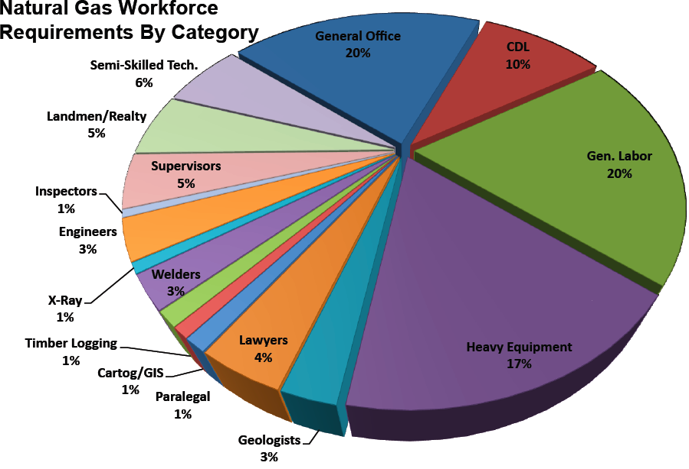
Workforce development will be a key to supporting the industry’s growth.
p. 7
NEEDS
“Drilling” workforce demands are varied, with a majority associated with field work.
Environmental & economic policies, as well as public perception, are dynamic and uncertain.
Differentiated workforce development partners will be those with the functional expertise, efficient delivery and timely content to ensure compliant, efficient and uninterrupted operations.
Sources: Marcellus Shale Workforce Needs Assessment,
Southwestern Pennsylvania; team analysis.

Slide 8
Experience demonstrates the importance of knowledge and relationships.
p. 8
Examples
Launch of software products business for transportation safety, compliance and more efficient operation.
Introduction of a seasonal driver service to add important capacity in cold weather months.
Success Factors
Subject matter expertise.
Current awareness of issues, needs.
Visible, professional and service-oriented image.
Industry dedication, investment.

Slide 9
Strategies to accelerate learning, support market entry
p. 9
Leverage existing relationships (customers, suppliers, etc.) as development & entry partners for products & services. (Is anything you already offer have value?)
Avoid knee-jerk entry. Don’t forget who was here first (oil, gas, coal)—might become ‘white space.’
Engage industry consortia to more efficiently network, evaluate opportunities, test ideas and stay up-to date.
Consider use of subject matter experts to accelerate relationships, exposure and efficient use of resources.

Slide 10
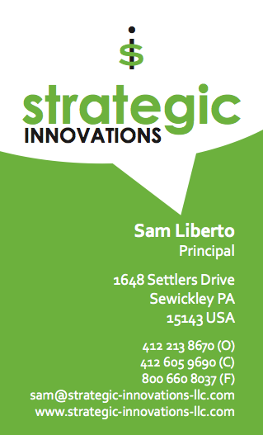
p. 10

Slide 11
DISCLAIMER
p. 11
The findings and recommendations contained in this report are based on Strategic Innovations' independent analysis, but also rely on information supplied by sources believed to be reliable. While every effort is made to use Strategic Innovations' knowledge and experience in the industry to prepare this report, and Strategic Innovations warrants that it has and will perform its duties in a workmanlike manner in accordance with commercially reasonable standards, Strategic Innovations does not guarantee the accuracy, adequacy, or completeness of any information provided by Strategic Innovations or other sources and Strategic Innovations is not responsible for any errors or omissions, or the results obtained from the use of such information that is provided by this report.
The information in this report is provided without warranty, express or implied, including but not limited to any implied warranties of merchantability or fitness for a particular purpose, and is used at the user’s own risk. The opinions contained in this report and all Strategic Innovations communications reflect our judgment at the time of writing and are subject to change without notice, including without limitation in connection with changes in the laws and regulations cited in this report.
IN NO EVENT SHALL STRATEGIC INNOVATIONS BE LIABLE FOR CONSEQUENTIAL, INCIDENTAL, PUNITIVE, SPECIAL, EXEMPLARY OR INDIRECT DAMAGES OR EXPENSES (INCLUDING, WITHOUT LIMITATION, LOST PROFITS OR OTHER ECONOMIC LOSS, LOST REIMBURSEMENTS, LOST DATA, OR LOST SAVINGS), EVEN IF STRATEGIC INNOVATIONS WAS ADVISED OF THE POSSIBILITY OF THE OCCURRENCE OF SUCH DAMAGES.

